Slide 1
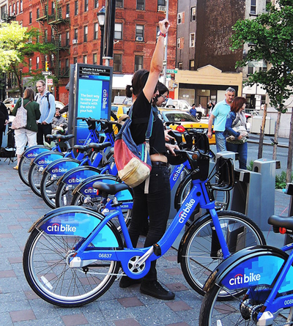
Story
Citi Bike Analytics

Slide 2
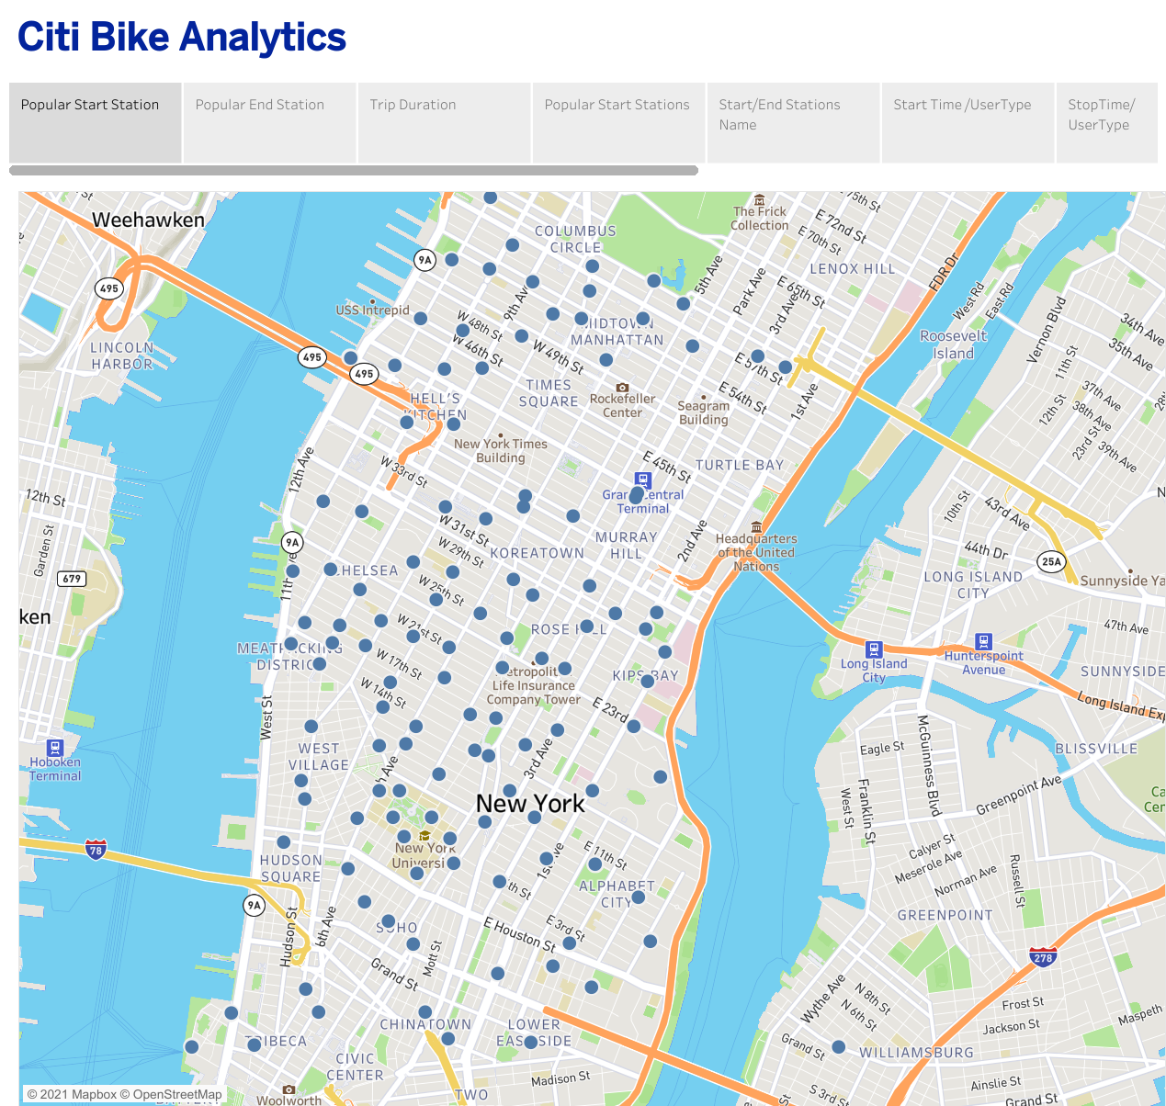
This Slide shows the most popular
Start Stations in NY city.

Slide 3
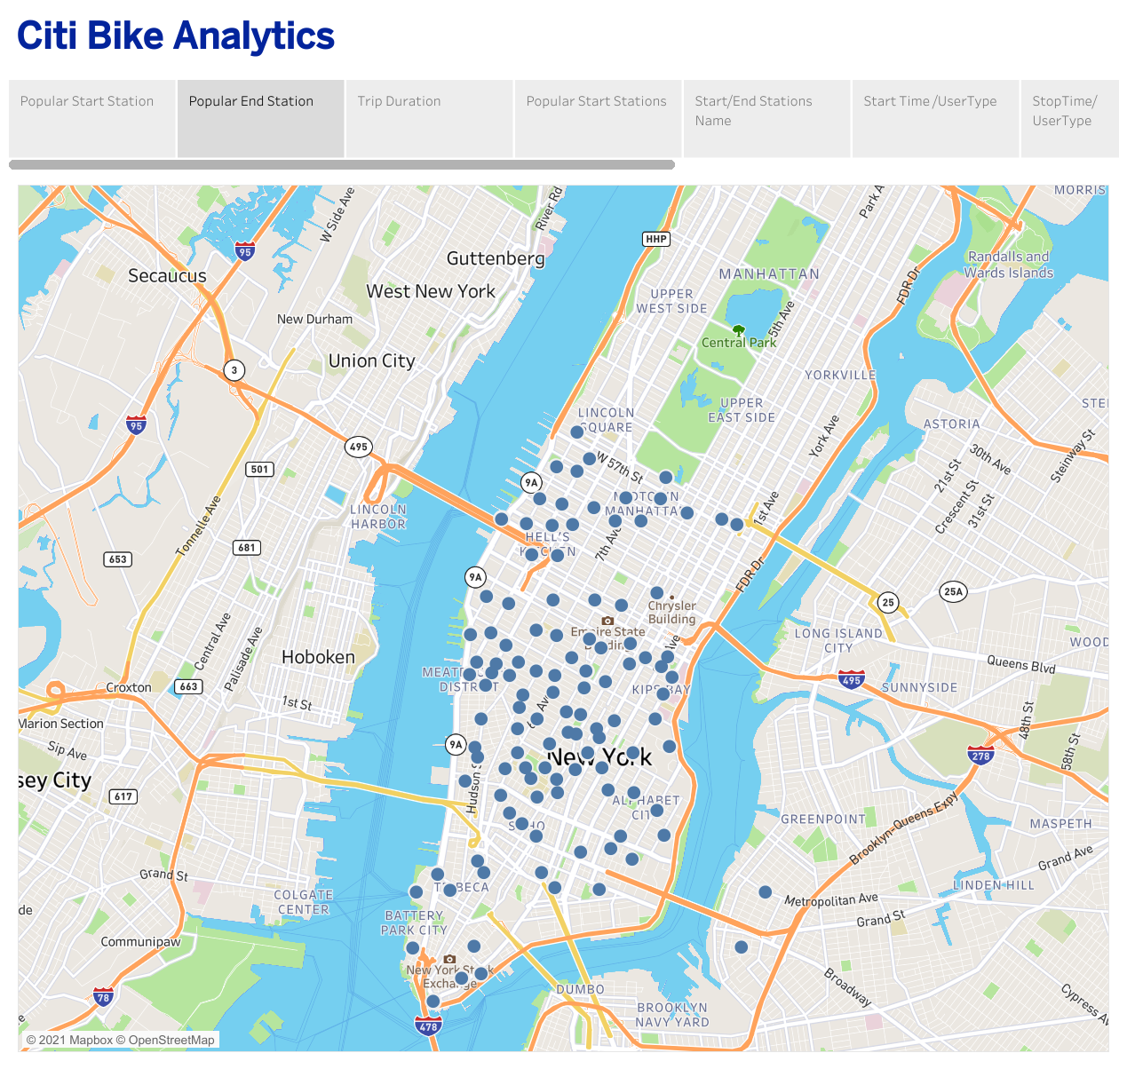
This Slide shows the most popular
End Stations
in NY city.

Slide 4
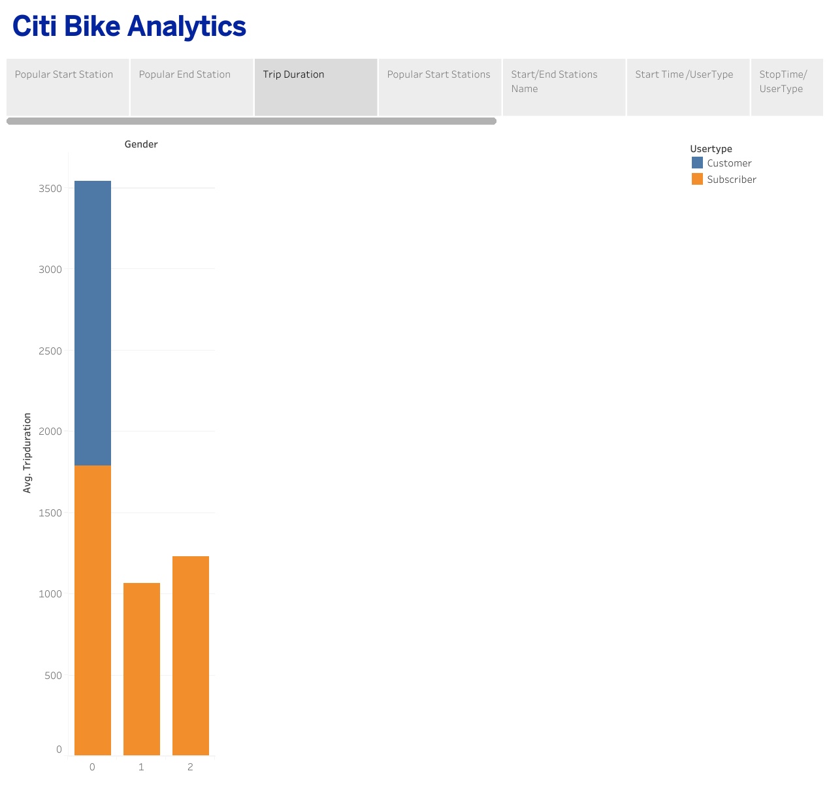
The relation between user types and average trip duration indicates customers have longer trip duration than average trip duration.

Slide 5
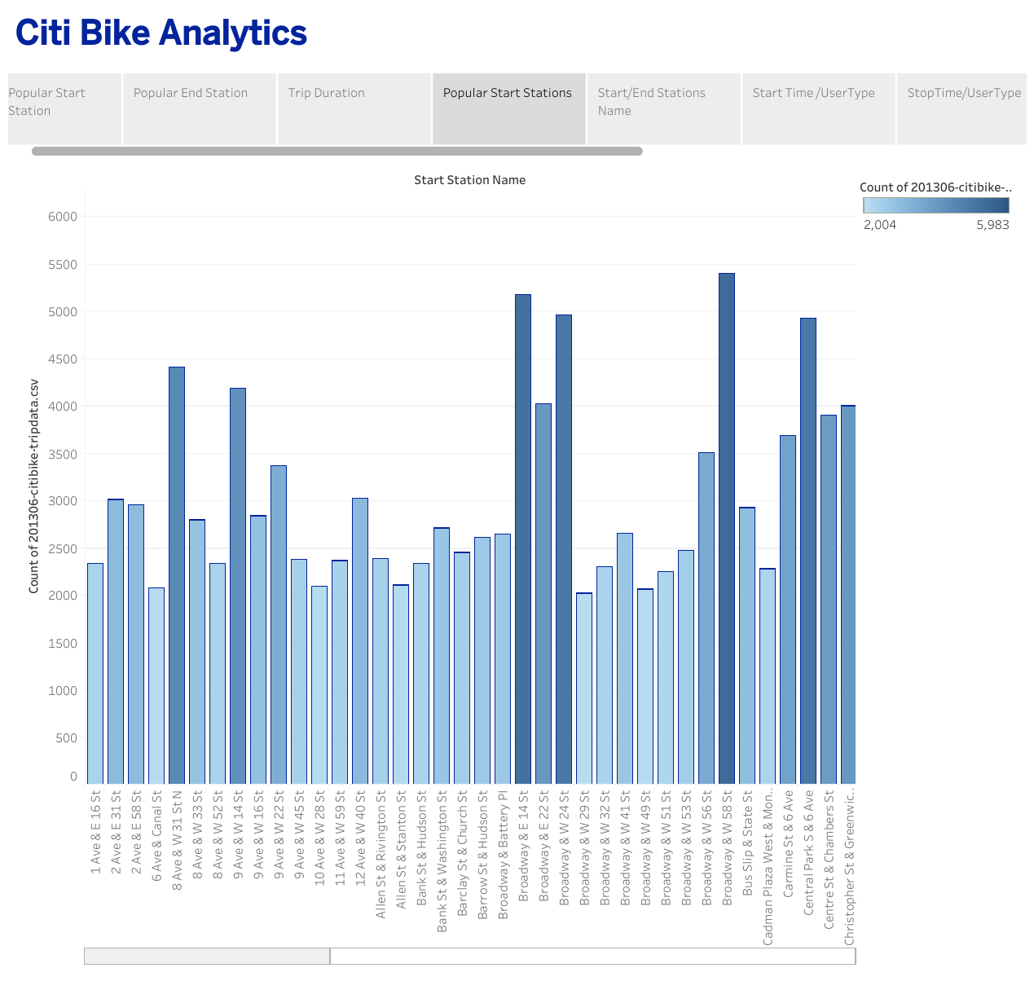
The most popular start stations Names are categorized based on the count of start biking stations.
W 20 St & 11 Ave, E17 St
& Broadway, Broadway &
W 58 St are the most popular start stations.

Slide 6
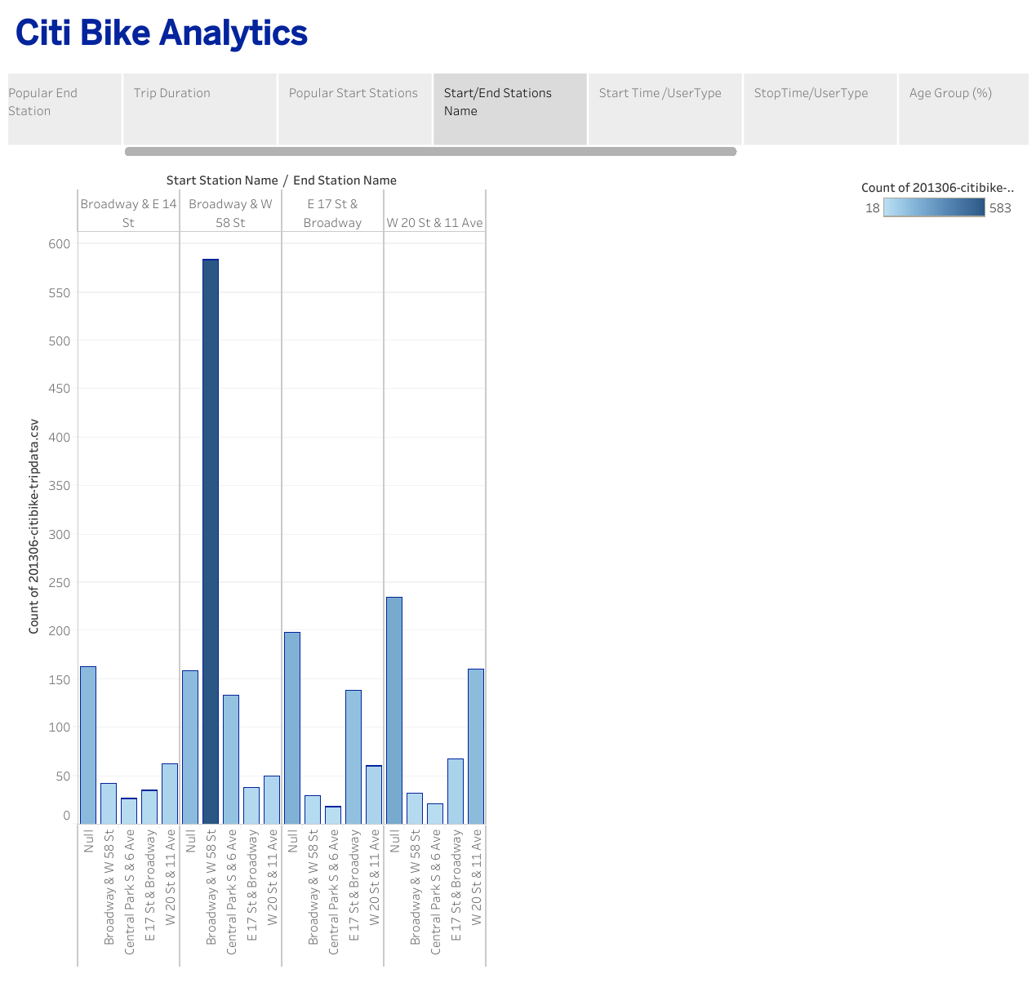
The popular start/ end stations greater or equal to 5000 are indicated on the slide.
The most popular start/ end station is Broadway & W 58 St

Slide 7
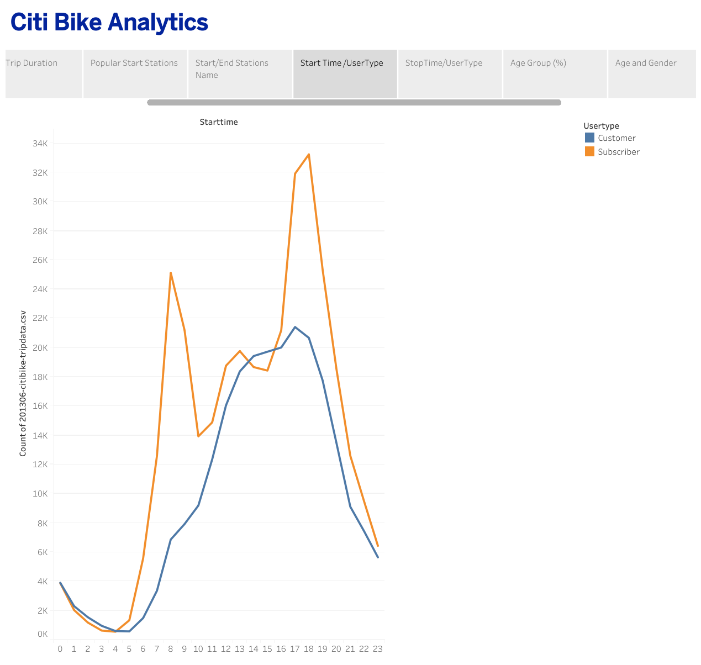
The analysis of start time for two user groups shows considerable growth for subscribers at 8 o’clock and 18. This probably is related to workday start and finish time.

Slide 8
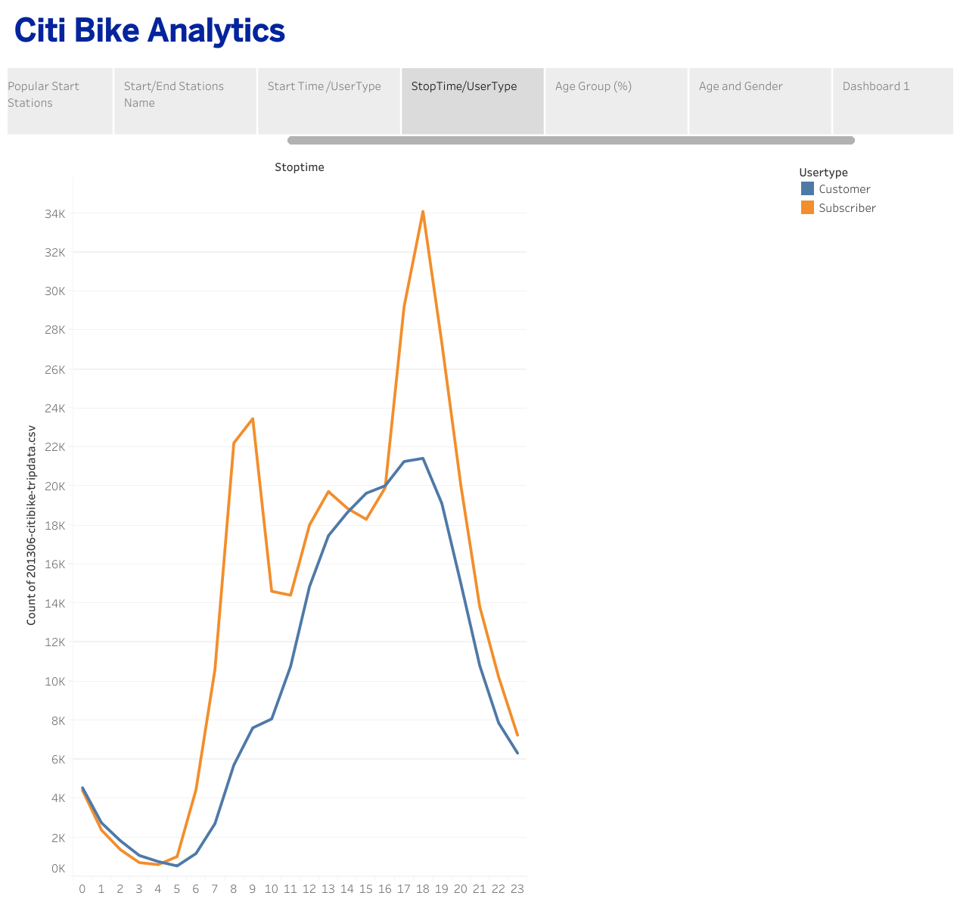
The analysis of stop time for two user groups indicates considerable growth for subscribers at 9 o’clock and 18.
This probably is related to workday start and finish time.

Slide 9
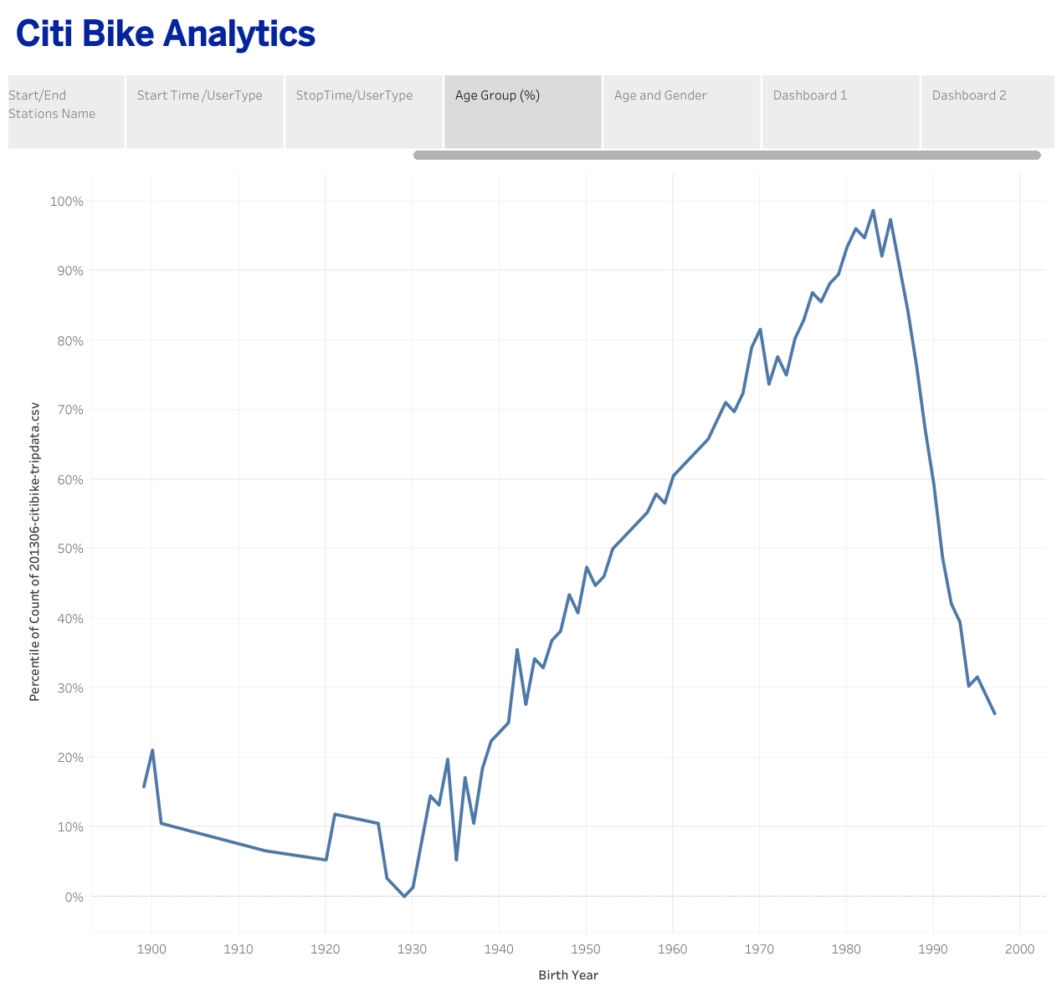
Analyzing the age of bike users indicates the users born in 1980 to 1985 are the most bike users.

Slide 10
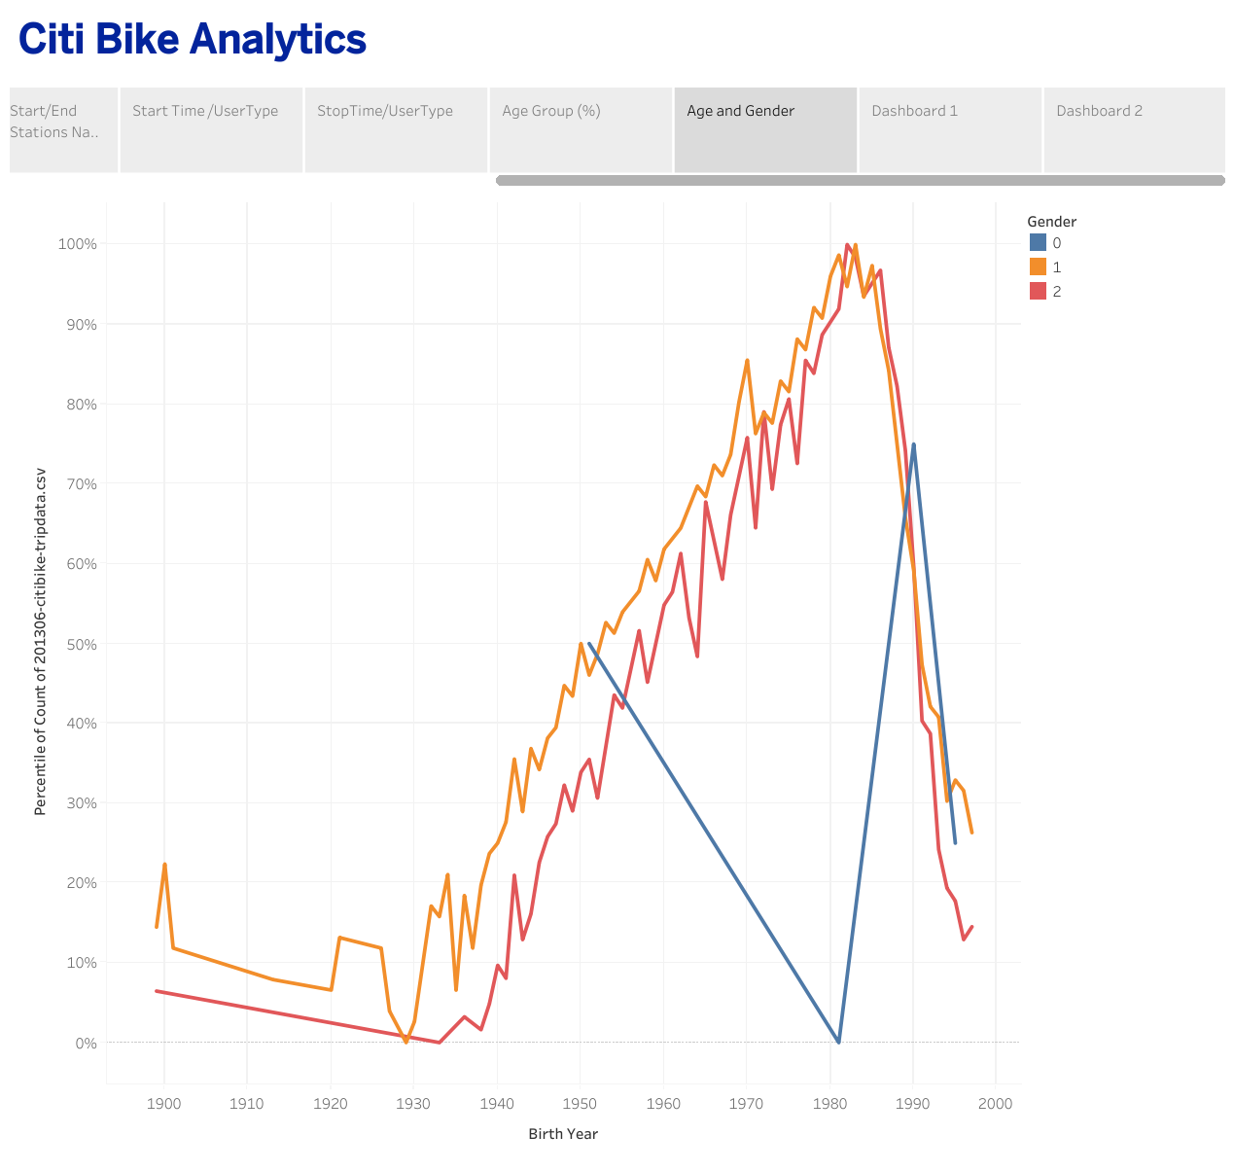
Relation between age group and gender of bike users indicate no meaningful difference between gender 1 and 2 who were born 1980 to 1985

Slide 11
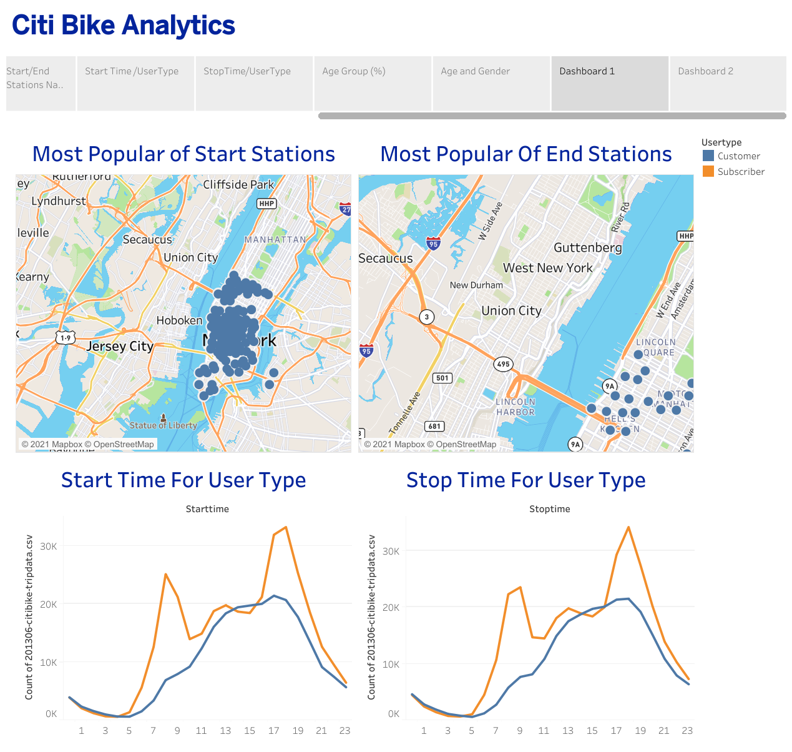
Dashboard 1 indicates the relation between the start and stops time for user groups.

Slide 12
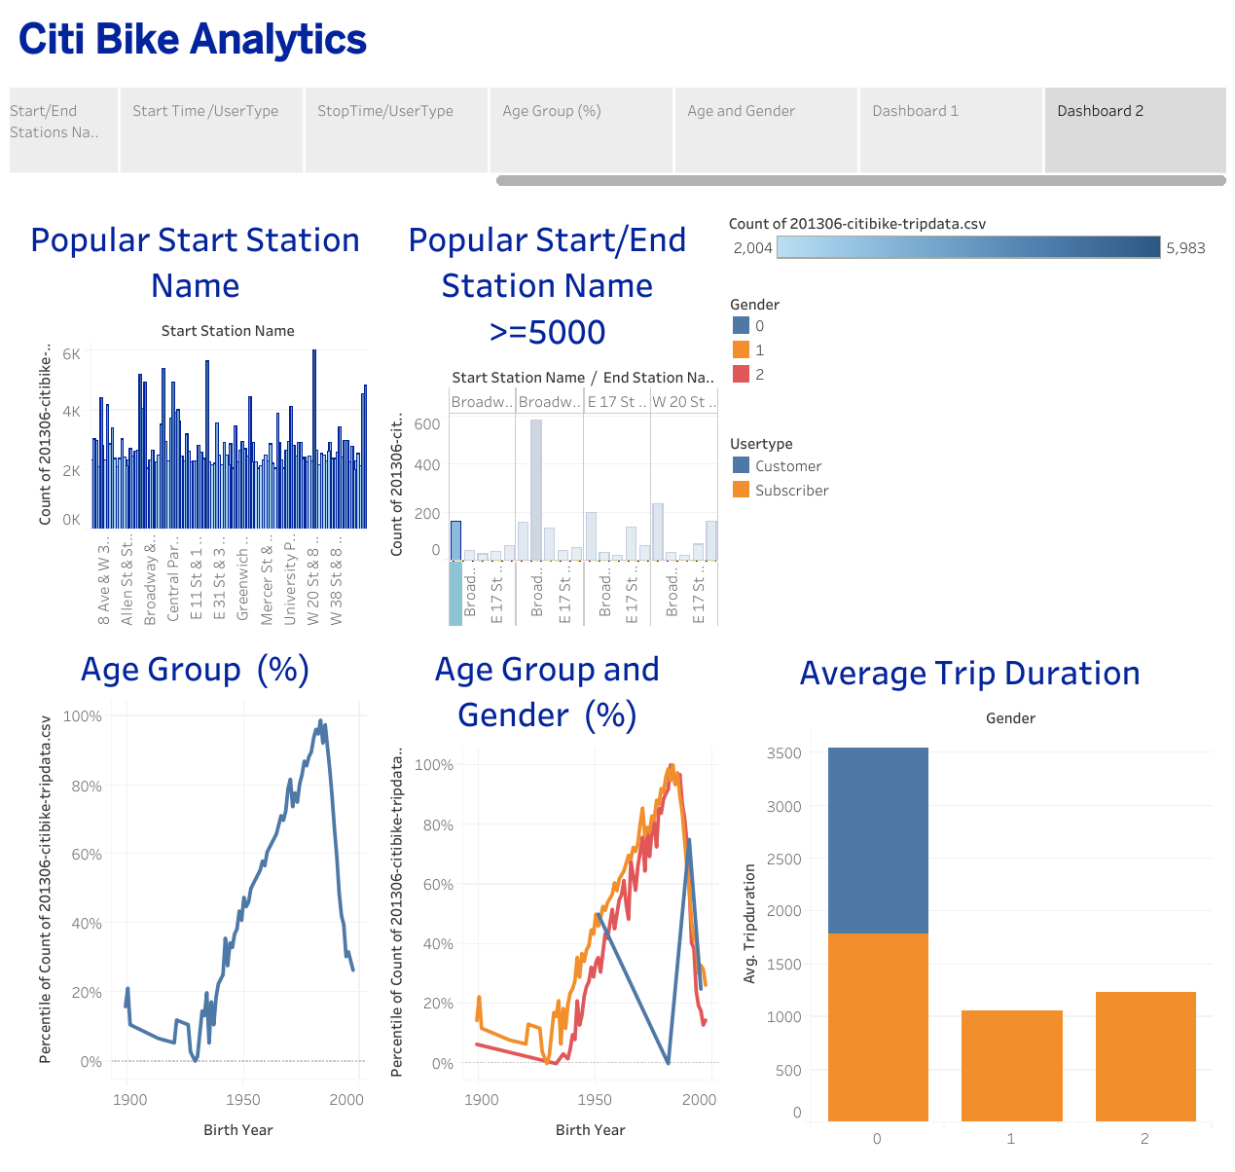
Dashboard 2 indicates the relation between age group and gender with trip duration.

